Slide 1
Online Debate: Where do we go from here?
Carly Watson
Director of Debate, Michigan State University

Slide 2
Background
MSU’s debate camp – the Spartan Debate Institute – began experimenting with online competitions and instruction in summer 2019
Original plans for 2020 SDI included a hybrid option for students
What promise did we see in online programming?
Program Design
Accessibility
Flexibility
Logistics
COVID-19 raised important questions about the future of online debate

Slide 3
Methodology
Used MSU’s survey platform – Qualtrics – to distribute “Midyear Online Debate Survey” over seven days
176 responses
Affiliation primarily with policy debate (76.9%)
Respondents skewed younger (79.5% were 34 or younger) and while, there was some racial diversity, respondents who reported their race as black were only 4.0% of respondents (suggesting under-sampling relative to the general population)
Topics:
Experience with online debate before COVID-19
Experience with online debate during COVID-19 travel restrictions
Opinions about what tournaments should look like after COVID-19

Slide 4
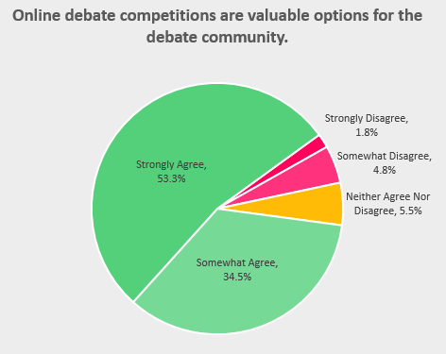
Results: Where We Are
Strong support for the value of online debate
87.9% of respondents selected “Strongly Agree” or “Somewhat Agree” when asked if they felt that online debate competitions were valuable options for the debate community

Slide 5
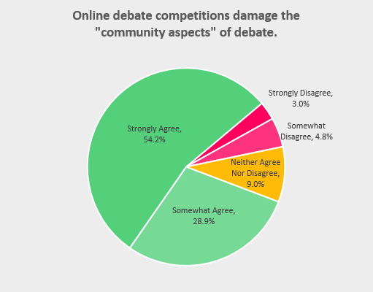
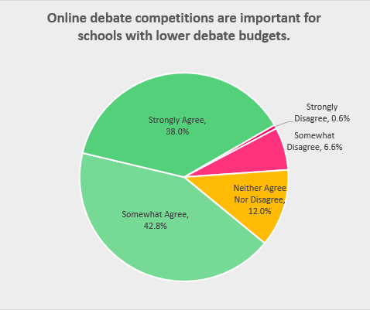
Results: Where We Are
Support based on online debate being beneficial for geographically isolated schools and schools with lower budgets
83.7% of survey respondents said that they “Strongly Agree” or “Somewhat Agree” that online debate competitions are importation for geographically isolated schools
80.7% of survey respondents said that they “Strongly Agree” or “Somewhat Agree” that online debate is important for schools with lower budgets
The largest concern with online debate competitions was a loss of community.
83.1% of respondents said that they “Strongly Agree” or “Somewhat Agree” that online debate competitions damage the community aspects of debate

Slide 6
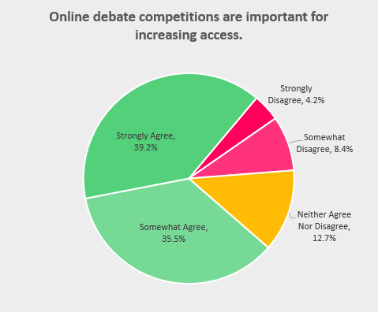
Results: Where We Are
Does online debate “increase access”?
74.7% of respondents said that they “Strongly Agree” or “Somewhat Agree” that online debate competitions increase access
50.0% respondents “Strongly Agree” or “Somewhat Agree” that online debate competitions are important for Urban Debate League Schools (only 10.8% “Strongly Disagree” or “Somewhat Disagree” with that statement)

Slide 7
Results: Now What
There is support from survey respondents for online debate competitions to continue after COVID-19
The survey asked respondents to agree or disagree with the statement “Online debate competitions should be eliminated after travel restrictions are eased” and 59.4% selected “Strongly Disagree” or “Somewhat Disagree” with that statement (as opposed to 31.1% that “Somewhat Agree” or “Strongly Agree”)
Little support for proposals using online tournaments for either regional tournaments or larger tournaments (e.g. all regional tournaments are online and larger tournament are held in person)
Some support for “hybrid models” (e.g. letting judges or competitors participate remotely at “in-person” tournaments)
52.7% of survey respondents said that they “Strongly Agree” or “Somewhat Agree” that judges should be able to participate at in-person tournaments online and 49.1% said that they “Strongly Agree” or “Somewhat Agree” that competitors should be able to compete at in-person tournaments online

Slide 8
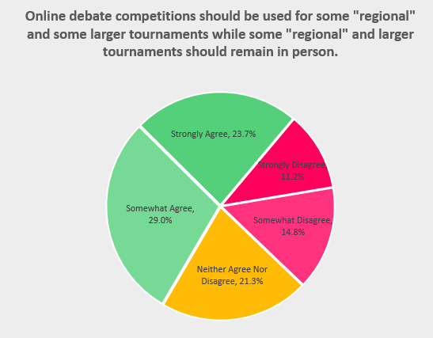
Results: Now What
Some consensus around a “mix” of tournaments being online
52.7% of survey respondents selected “Strongly Agree” or “Somewhat Agree” that some regional tournaments and some larger tournaments should be held online and some should remain in person.

Slide 9
Closing Thoughts
Survey shortcomings and space for additional research
Uncertain budgets after COVID-19
Recommendations for future online debate:
Additional resources/attention are needed to address hardware gaps (e.g. lack of reliable internet)
More deliberate focus on preserving the community aspects of debate is required
More exploration needed on “hybrid” models (e.g. should they have to be separate divisions)
Additional Resources:
Blog Post & Raw Survey Results
SDI webinar with current high school debaters and current coaches reflecting on online debate

Slide 10
Thank you!
Carly Watson
debate@msu.edu

